Slide 1
welcome to
COMP 2691
Intermediate Windows Application Development in .NET
Week 7
Threading
Amir Ahani, M.Sc. + MBA
Microsoft Certified Solution Developer (MCSD .NET)
Microsoft Certified Database Administrator (MCDBA)
Email: amirahani@gmail.com
<number> of 63
Notes:
COMP2690 Windows Application Development with C#

Slide 2
Today…
Creating Threads
  Simple Threads
  Passing Data to Threads
  Stopping Threads
  Execution Context
Sharing Data
  Avoiding Collisions
  Synchronization Locks
Asynchronous Programming Model (APM)
  Understanding Asynchronous Programming
  Understanding the Thread Pool
  Understanding Timer Objects
Lab: Use the Thread Class to Demonstrate Multithreading
Lab: Use a Mutex to Create a Single-Instance Application
Lab: Use the ThreadPool to Queue Work Items
<number> of 63
Notes:
COMP2690 Windows Application Development with C#

Slide 3
Threading
  Threading is an important concept in software development.
  The basic concept behind threading is to perform multiple
  operations concurrently. Each of these operations can be
  thought of as a separate thread of logic. Most operations have
  downtime, where an operation is waiting for something else to
  happen (for example, waiting for a response from a Web server
  or waiting for a resource to become available).
  With threading, you can have the processor or processors
  of a machine continue to do other work during that time.
<number> of 63
Notes:
COMP2690 Windows Application Development with C#

Slide 4
Creating Threads
  Threads are the basis of high-performance applications.
  In the .NET Framework, the System.Threading namespace
  contains the types that are used to create and manage multiple
  threads in an application.
<number> of 63
Notes:
COMP2690 Windows Application Development with C#

Slide 5
Simple Threads
  To start working with threads, you must become acquainted with
  the Thread class.
  This class exemplifies a single thread. The Thread class is used
  to create and start threads.
<number> of 63
Notes:
COMP2690 Windows Application Development with C#

Slide 6
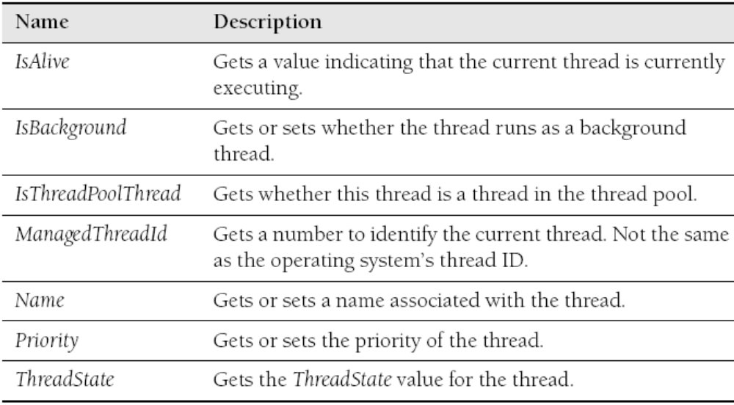
Thread Class
  Properties:
<number> of 63
Notes:
COMP2690 Windows Application Development with C#

Slide 7
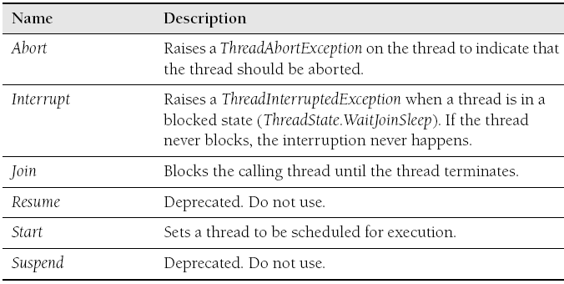
Thread Class
  Methods:
<number> of 63
Notes:
COMP2690 Windows Application Development with C#

Slide 8
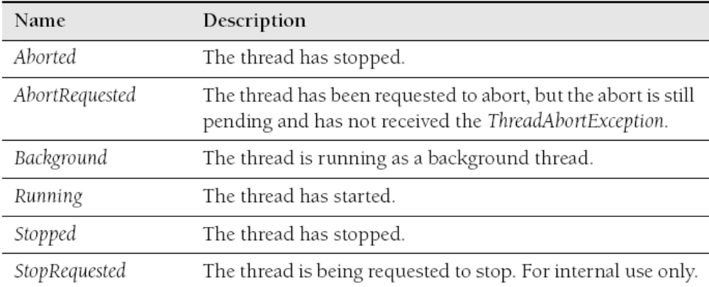
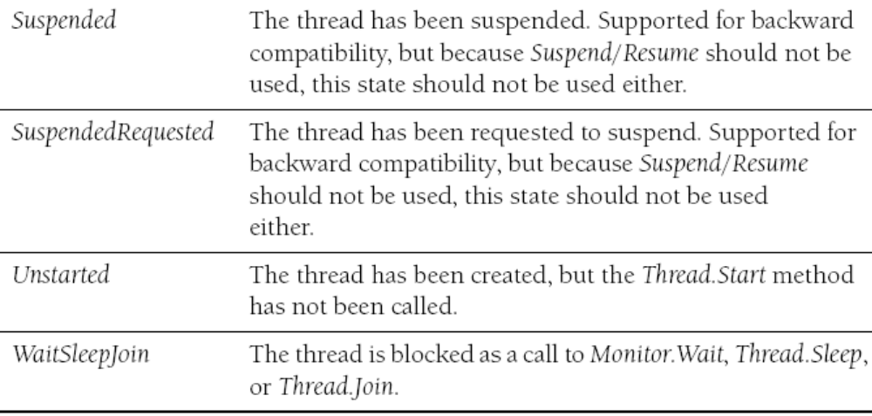
Thread Class
  ThreadState Enumerations:
<number> of 63
Notes:
COMP2690 Windows Application Development with C#

Slide 9
Thread Class
Example 1: Creating a Thread
ThreadStart operation = new ThreadStart (SimpleWork);
// Creates, but does not start, a new thread
Thread theThread = new Thread(operation);
// Starts the work on a new thread
theThread.Start();
static void SimpleWork()
{
Console.WriteLine("Thread: {0}",
Thread.CurrentThread.ManagedThreadId);
}
<number> of 63
Notes:
COMP2690 Windows Application Development with C#

Slide 10
Thread Class
Example 2: Using Multiple Threads
ThreadStart operation = new ThreadStart(SimpleWork);
for (int x = 1; x <= 5; ++x)
{
// Creates, but does not start, a new thread
Thread theThread = new Thread(operation);
// Starts the work on a new thread
theThread.Start();
}
static void SimpleWork()
{
Console.WriteLine("Thread: {0}",
Thread.CurrentThread.ManagedThreadId);
}
<number> of 63
Notes:
COMP2690 Windows Application Development with C#

Slide 11
Thread Class
Example 3: Using Multiple Threads
ThreadStart operation = new ThreadStart(SimpleWork);
for (int x = 1; x <= 5; ++x)
{
Thread theThread = new Thread(operation);
theThread.Start();
}
static void SimpleWork()
{
for (int x = 1; x <= 10; ++x)
{ Console.WriteLine("Thread: {0}",
Thread.CurrentThread.ManagedThreadId);
// Slow down thread and let other threads work
Thread.Sleep(10);
}
}
<number> of 63
Notes:
COMP2690 Windows Application Development with C#

Slide 12
Thread Class
  Using Thread.Join
  More often than not, you will need your application to wait for a
  thread to complete execution. To accomplish this, the Thread
  class supports the Join method:
  The Join method tells the system to make your application wait
  until the thread has completed.
theThread.Join( );
<number> of 63
Notes:
COMP2690 Windows Application Development with C#

Slide 13
Thread Class
Example : Join
ThreadStart operation = new ThreadStart(SomeWork);
Thread[] theThreads = new Thread[5];
for (int x = 0; x < 5; ++x)
{
// Creates, but does not start, a new thread
theThreads[x] = new Thread(operation);
// Starts the work on a new thread
theThreads[x].Start();
}
// Wait for each thread to complete
foreach (Thread t in theThreads)
{
t.Join();
}
<number> of 63
Notes:
COMP2690 Windows Application Development with C#

Slide 14
Thread Class
  Thread Priority
  The Thread class supports the setting or getting of the priority of
  a thread using the ThreadPriority enumeration.
  Threads are scheduled based on this enumeration. In most cases,
  you will want to use the default (Normal).
  Deciding to use threads that have higher or lower thread priority
  can cause the operation system to starve a thread more than you
  might expect, or if you use higher priorities (especially Highest),
  you can starve the system.
<number> of 63
Notes:
COMP2690 Windows Application Development with C#

Slide 15
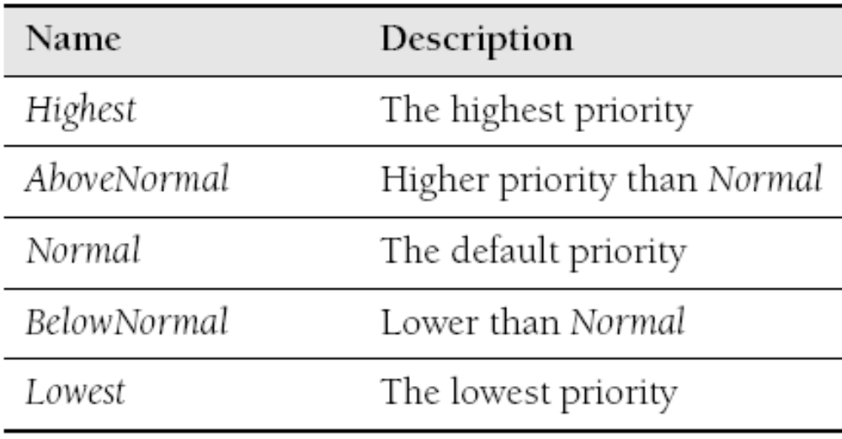
Thread Class
  ThreadPriority Enumeration Values:
<number> of 63
Notes:
COMP2690 Windows Application Development with C#

Slide 16
Thread Class
  Passing Data to Threads
  In each of the earlier examples, we were using the StartThread
  delegate, which takes no parameters. In most real-world use of
  threading, you will need to pass information to individual threads.
  To do this, you need to use a new delegate called Parameterized-
  StartThread.
  This delegate specifies a method signature with a single parameter
  of type Object and returns nothing.
<number> of 63
Notes:
COMP2690 Windows Application Development with C#

Slide 17
Thread Class
Example : Passing Data
ParameterizedThreadStart operation =
new ParameterizedThreadStart(WorkWithParameter);
Thread theThread = new Thread(operation);
// Starts the work on a new thread
theThread.Start("Hello");
// A Second Thread with a different parameter
Thread newThread = new Thread(operation);
newThread.Start("Goodbye");
static void WorkWithParameter(object o) {
string info = (string) o;
for (int x = 0; x < 10; ++x) {
Console.WriteLine("{0}: {1}", info,
Thread.CurrentThread.ManagedThreadId);
Thread.Sleep(10); }
}
<number> of 63
Notes:
COMP2690 Windows Application Development with C#

Slide 18
Thread Class
  Stopping Threads
  Controlling threads in your applications often requires that you be
  able to stop threads. The primary mechanism for stopping threads
  is to use the Thread.Abort method. When the Thread.Abort
  method is called, the threading system prepares to throw a
  ThreadAbortException in the thread. Whether the exception is
  caught or not, the thread is stopped after it is thrown.
<number> of 63
Notes:
COMP2690 Windows Application Development with C#

Slide 19
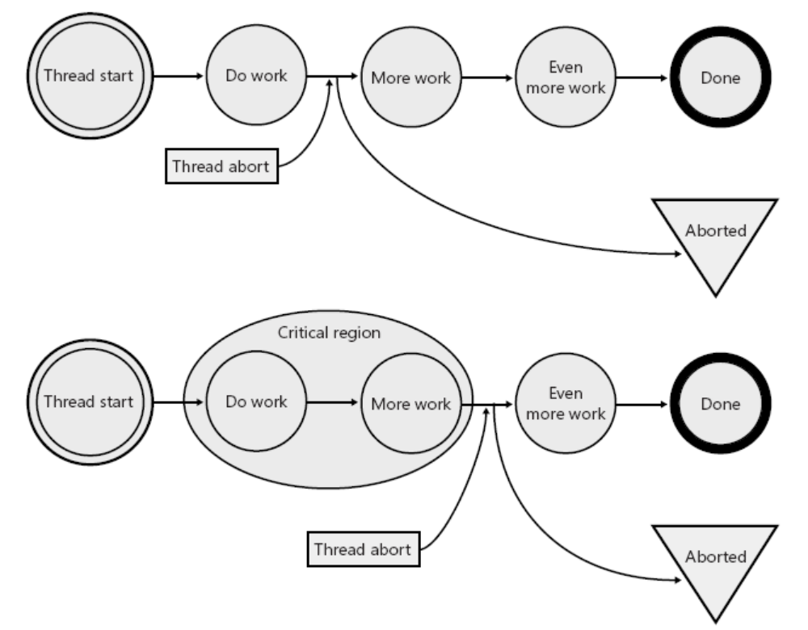
Thread Class
Example : Stopping Threads
  Because the AbortThisThread method never catches the ThreadAbortException,
  this thread stops at the line currently executing when the main thread calls Abort
  to kill the thread. This is a problem because the thread system doesn’t know
  where it can safely kill the thread. Aborting the thread in the wrong place in the
  code could leave data in an inconsistent state. For example, if
  theThreadAbortException is thrown between the setting of the IsValid and
  IsComplete properties, the SomeClass object might be left in an inconsistent
  state. If the ThreadAbortException is thrown after the code writes the properties
  but before the code calls the WriteToConsole method, our object will be
  consistent. Thread class has two important static methods: BeginCriticalRegion
  and EndCriticalRegion. We can add calls to these methods to tell the threading
  system that it can abort this thread, just not within this critical region.
Thread newThread = new Thread(newThreadStart(AbortThisThread));
newThread.Start();
newThread.Abort();
static void AbortThisThread()
{
// Setting data
Thread.BeginCriticalRegion();
SomeClass.IsValid = true;
SomeClass.IsComplete = true;
Thread.EndCriticalRegion();
// Write the object to the console
SomeClass.WriteToConsole();
}
Thread newThread = new Thread(newThreadStart(AbortThisThread));
newThread.Start();
newThread.Abort();
static void AbortThisThread()
{
// Setting data
SomeClass.IsValid = true;
SomeClass.IsComplete = true;
// Write the object to the console
SomeClass.WriteToConsole();
}
<number> of 63
Notes:
COMP2690 Windows Application Development with C#

Slide 20
Lab: Use the Thread Class
In this lab, you create a simple console application and start two threads simultaneously.
<number> of 63

Slide 21
Sharing Data
  The most challenging part of working with threads is sharing data
  between multiple threads. Once you start to work with multiple
  threads in an application, you become responsible for the
  protection of any shared data that can be accessed from multiple
  threads. Lucky for us that the .NET Framework makes that very
  straightforward.
<number> of 63
Notes:
COMP2690 Windows Application Development with C#

Slide 22
Sharing Data
  Avoiding Collisions
  Before threading became available, you could expect that any
  access of data was being done by one object at a time. Now that
  we have entered the multithreaded world, we have to deal with the
  fact that multiple threads might be interrogating our objects
  simultaneously. This causes problems in some deceptive ways.
<number> of 63
Notes:
COMP2690 Windows Application Development with C#

Slide 23
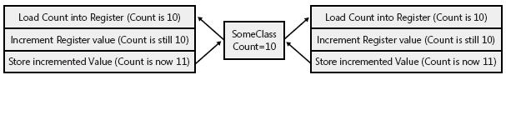
Sharing Data
Example : Avoiding Collisions
ThreadStart starter = new ThreadStart(UpdateCount);
Thread[] threads = new Thread[10];
for (int x = 0; x < 10; ++x) {
threads[x] = new Thread(starter);
threads[x].Start(); }
// Wait for them to complete
for (int x = 0; x < 10; ++x) { threads[x].Join(); }
// Show to the console the total count
// Should be 10 * 10,000 = 100,000
Console.WriteLine("Total: {0}", Counter.Count);
If you are working with a single processor without Hyper-
Threading support, this code will probably always work as
expected. But if you run this code several times on a
multiprocessor or Hyper-Threaded machine, you will see that
sometimes the resulting number is less than the 100,000
expected.
This happens because of the way that updating the Count
field works on the processor.
On most computers, this code resolves into three steps:
1. Load the value into a register inside the processor.
2. Increment (or decrement) the value in the register.
3. Copy the value from the register back to memory.
The problem is that in threaded code all these three steps are
treated as atomic operations. As shown in the following
figure, two threads could each read the values into memory
and update them with the same updated value. This is why
the code just shown loses some counts.
public class Counter { public static int Count; }
static void UpdateCount()
{
for (int x = 1; x <= 10000; ++x)
{ Counter.Count = Counter.Count + 1; }
}
<number> of 63
Notes:
COMP2690 Windows Application Development with C#

Slide 24
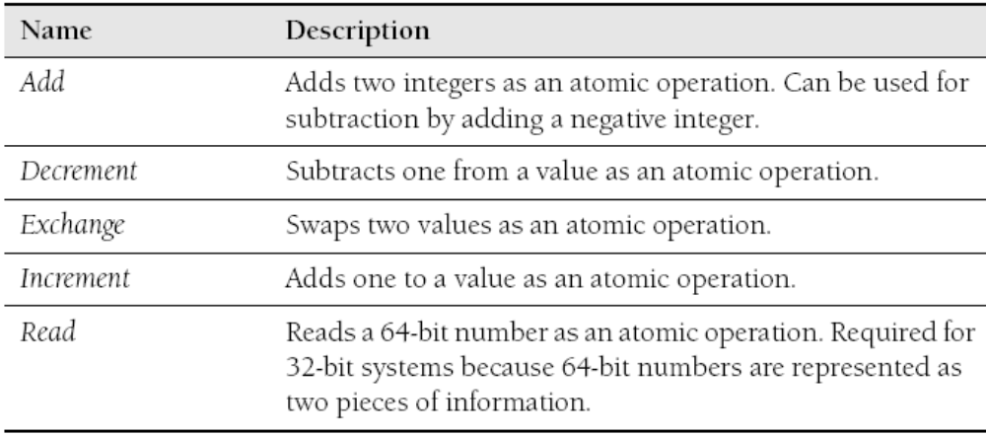
Sharing Data
  Avoiding Collisions using Interlocked
  Interlocked Static Methods:
<number> of 63
Notes:
COMP2690 Windows Application Development with C#

Slide 25

Sharing Data
Example : Avoiding Collisions using Interlocked
ThreadStart starter = new ThreadStart(UpdateCount);
Thread[] threads = new Thread[10];
for (int x = 0; x < 10; ++x) {
threads[x] = new Thread(starter);
threads[x].Start(); }
// Wait for them to complete
for (int x = 0; x < 10; ++x) { threads[x].Join(); }
// Show to the console the total count
// Should be 10 * 10,000 = 100,000
Console.WriteLine("Total: {0}", Counter.Count);
Interlocked.Increment(ref Counter.Count);
By using the Interlocked.Increment method and
passing in a reference to the value you want to
increment, you are guaranteed that the increment
operation is atomic, so your problem goes away. The
main problem with the Interlocked class is that it
works with a small set of .NET types. What if you need
to synchronize access to your own classes or treat
Larger pieces of code as atomic? How do you ensure
that other types of code are protected from multiple
thread access?
Synchronization locks address all these issues.
public class Counter { public static int Count; }
static void UpdateCount()
{
for (int x = 1; x <= 10000; ++x)
{ // Counter.Count = Counter.Count + 1;
Interlocked.Increment(ref Counter.Count); }
}
<number> of 63
Notes:
COMP2690 Windows Application Development with C#

Slide 26
Sharing Data
  Synchronization Locks
  The purpose of synchronization locks is to allow you to synchronize
  access to objects in .NET. Although synchronization locks will solve
  many thread synchronization problems, they can introduce a
  problem known as deadlocks.
<number> of 63
Notes:
COMP2690 Windows Application Development with C#

Slide 27
Sharing Data
Example : Synchronization Lock using lock keyword
Even though using the keywords in C# are often the easiest
Ways to create synchronization locks, you might need to
have more control over the way you are creating a lock.
Underneath the covers, the synchronization locks are just
using the Monitor Class to perform the synchronization.
By replacing the Interlocked class code with a synchronization
lock, we can ensure that only one thread at a time can enter the
locked section of code. The lock requires you to specify an object
to use as the lock’s identifier. For code that manipulates several
pieces of data within a class, you can use the current instance of
the class (this).
The synchronization lock works by blocking other threads from
access to the code while a thread is inside the lock. For example,
the first thread will cause this piece of code to be locked based on
the instance of the class. The second thread will wait until the first
thread exits the lock before it enters the lock, and so on for
additional threads.
public void UpdateCount()
{
lock (this)
{
_count = _count + 1;
if (Count % 2 == 0) // An even number
{
_evenCount = _evenCount + 1;
}
}
}
<number> of 63
Notes:
COMP2690 Windows Application Development with C#

Slide 28
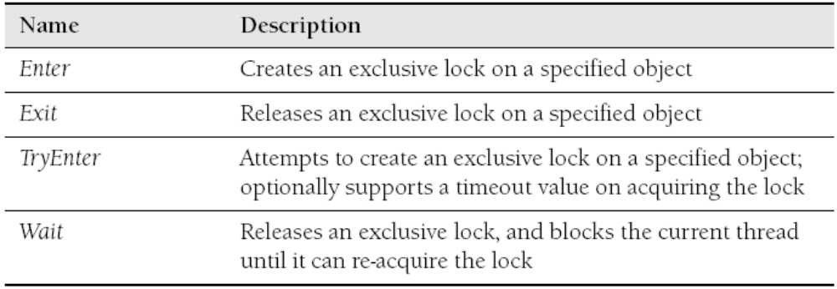
Sharing Data
  Monitor Static Methods:
<number> of 63
Notes:
COMP2690 Windows Application Development with C#

Slide 29
Sharing Data
Example : Synchronization Lock using Monitor Class
public void UpdateCount()
{
Monitor.Enter(this);
try
{
_count = _count + 1;
if (Count % 2 == 0) // An even number
{
_evenCount = _evenCount + 1;
}
}
finally
{
Monitor.Exit(this);
}
}
<number> of 63
Notes:
COMP2690 Windows Application Development with C#

Slide 30
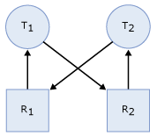
Sharing Data
  Understanding Deadlocks
  A deadlock is a case where two pieces of code are trying to access
  the same objects but are blocking each other from getting at the
  resources.
Thread T1 has a lock on resource R1 (indicated by the arrow from R1 to T1) and has requested a lock on resource R2 (indicated by the arrow from T1 to R2).
Thread T2 has a lock on resource R2 (indicated by the arrow from R2 to T2) and has requested a lock on resource R1 (indicated by the arrow from T2 to R1).
Because neither thread can continue until a resource is available and neither resource can be released until a thread continues, a deadlock state exists.
<number> of 63
Notes:
COMP2690 Windows Application Development with C#

Slide 31
Sharing Data
Example : Deadlock
Deadlocker deadlock = new Deadlocker();
ThreadStart T1Start = new ThreadStart(deadlock.First);
ThreadStart T2Start = new ThreadStart(deadlock.Second);
Thread T1= new Thread(T1Start);
Thread T2 = new Thread(T2Start);
T1.Start();
T2.Start();
T1.Join();
T2.Join();
class Deadlocker
{
object R1 = new Object();
object R2 = new Object();
public void First()
{
lock (R1)
{
lock (R2)
{ Console.WriteLine("First"); }
}
}
public void Second()
{
lock (R2)
{
lock (R1)
{ Console.WriteLine("Second"); }
}
}
}
The deadlock happens like this:
1. T1 starts and locks R1.
2. T2 starts and locks R2.
3. T1 blocks waiting for R2 to be freed.
4. T2 blocks waiting for R1 to be freed.
5. The application stops in its tracks.
<number> of 63
Notes:
COMP2690 Windows Application Development with C#

Slide 32
Sharing Data
  Other Synchronization Methods
  Although the Monitor class is a useful (and lightweight) tool for
  developing threaded software, other synchronizing mechanisms
  have their own uses:
  ■ ReaderWriterLock Class
  ■ Synchronization with Windows kernel objects
    ❑ Mutex class
    ❑ Semaphore class
    ❑ AutoResetEvent class
    ❑ ManualResetEvent class
Optional
<number> of 63
Notes:
COMP2690 Windows Application Development with C#

Slide 33
Sharing Data
  Synchronization with ReaderWriterLock Class
  The purpose of the ReaderWriterLock is to differentiate between the
  two classes of code that can use certain resources.
  By using the ReaderWriterLock, you can lock access to readers
  and writers separately. The ReaderWriterLock allows multiple
  readers to access the data at the same time, but only a single
  writer can get a lock on the data. All readers must release their
  locks before a writer can get a lock on the data.
Optional
<number> of 63
Notes:
COMP2690 Windows Application Development with C#

Slide 34

Sharing Data
  ReaderWriterClass Properties:
Optional
<number> of 63
Notes:
COMP2690 Windows Application Development with C#

Slide 35
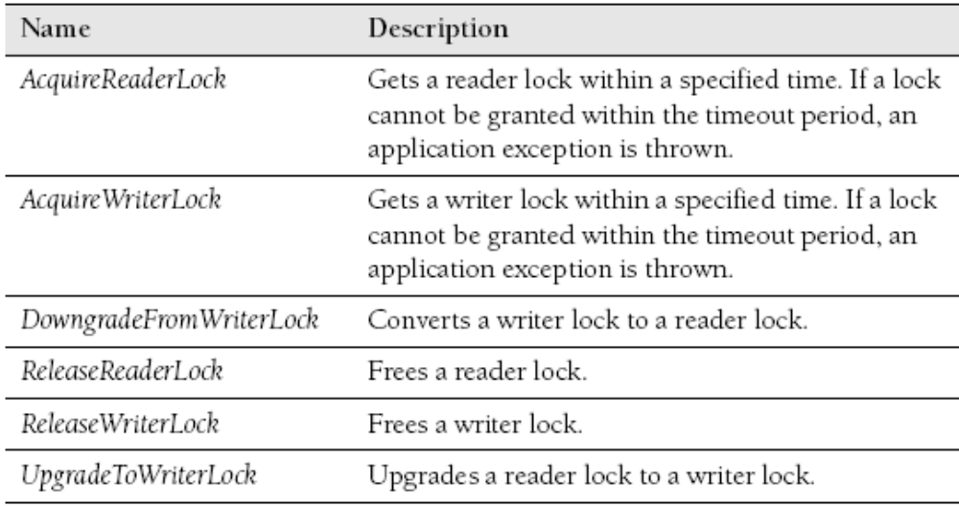
Sharing Data
  ReaderWriterClass Methods:
Optional
<number> of 63
Notes:
COMP2690 Windows Application Development with C#

Slide 36
Sharing Data
Example : Synchronization Lock using ReaderWriterLock
ReaderWriterLock rwLock = new ReaderWriterLock();
int counter = 0;
try
{
rwLock.AcquireReaderLock(100);
try
{
Console.WriteLine(counter);
}
finally
{
rwLock.ReleaseReaderLock();
}
}
catch (ApplicationException)
{
Console.WriteLine("Failed to get a Reader Lock");
}
Reader Lock
Optional
<number> of 63
Notes:
COMP2690 Windows Application Development with C#

Slide 37
Sharing Data
Example : Synchronization Lock using ReaderWriterLock
ReaderWriterLock rwLock = new ReaderWriterLock();
int counter = 0;
try
{
rwLock.AcquireWriterLock(1000);
try
{
Interlocked.Increment(ref counter);
}
finally
{
rwLock.ReleaseWriterLock();
}
}
catch (ApplicationException)
{
Console.WriteLine("Failed to get a Writer Lock");
}
Writer Lock
Optional
<number> of 63
Notes:
COMP2690 Windows Application Development with C#

Slide 38

Sharing Data
  Synchronization with Windows Kernel Objects
  At the operating-system level, there are three kernel objects—
  Mutex, Semaphore, and Event—whose job is to allow you to
  perform thread synchronization. Although these kernel objects
  provide powerful synchronization facilities, they are heavyweight
  objects.
  For example, using a Mutex to synchronize your threads instead of a
  Monitor is about 33 times slower (as pointed out by Jeffrey Richter
  in his book CLR via C#).
Even though these kernel objects come with additional
overhead, they allow you to perform synchronization tasks
that are impossible with the Monitor and ReaderWriterLock
Classes.
A Mutex allows synchronization (like a lock) across
AppDomain and process boundaries.
A Semaphore is used to throttle access to a resource to a
set number of threads.
An Event provides a way to notify to multiple threads
(across AppDomain and process boundaries) that some
event has Occurred.
Each of these synchronization objects is represented by
Classes in the .NET Framework (Mutex, Semaphore,
AutoResetEvent, and ManualResetEvent). These classes all
derive from a common class called a WaitHandle.
Optional
<number> of 63
Notes:
COMP2690 Windows Application Development with C#

Slide 39

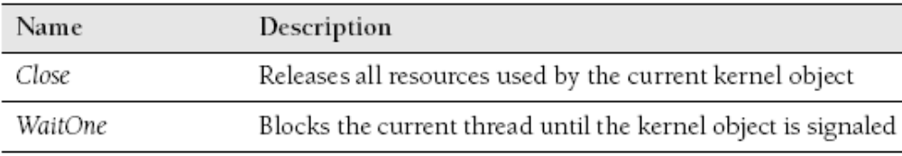
Sharing Data
  Synchronization with WaitHandle Class
  WaitHandle Property:
  WaitHandle Methods:
Optional
<number> of 63
Notes:
COMP2690 Windows Application Development with C#

Slide 40
Sharing Data
  Synchronization with Mutex Class
  The purpose of the Mutex class is to provide a locking mechanism,
  and it works in much the same way as the Monitor class. The major
  difference is that the Mutex class can lock data across AppDomain
  and process boundaries.
Optional
<number> of 63
Notes:
COMP2690 Windows Application Development with C#

Slide 41
Sharing Data
Example : Synchronization Lock using Mutex
// Open an existing “named Mutex”
Mutex theMutex = null;
// Try and open the Mutex
try
{
theMutex = Mutex.OpenExisting(“MyMutex");
}
catch (WaitHandleCannotBeOpenedException)
{
// Cannot open the Mutex because it doesn't exist
}
// Create it if it doesn't exist
if (theMutex == null)
{
theMutex = new Mutex(True, "MyMutex");
}
// Create a “named Mutex” → Visible throughout the OS
// Only one system object named "MyMutex" can exist.
Mutex objM = new Mutex(false, "MyMutex");
Console.WriteLine("Waiting for the Mutex.");
// Try to gain control of the named Mutex. If the Mutex is
// controlled by another thread, wait for it to be released.
if (objM.WaitOne(1000, false)) // wait 1 second for lock
{
try
{ // Do the work you need to do while having exclusive // access to the Mutex object.
}
finally
{
objM.ReleaseMutex();
}
}
else
{ // React to not getting the resource
// (e.g. notifying the // user) }
This example shows how a named mutex is used to signal
between processes or threads. Run this program from two (or
more) command windows. Each process creates a Mutex
object that represents the named mutex "MyMutex".
The named mutex is a system object whose lifetime is
bounded by the lifetimes of the Mutex objects that represent
it. The named mutex is created when the first process creates
this Mutex; in this example, the named mutex is owned by
the first process. The named mutex is destroyed when all the
Mutex objects that represent it have been released.
The constructor here: Mutex (Boolean initiallyOwned, String name)
cannot tell the calling thread whether initial ownership of the
named Mutex was granted. Therefore, do not request initial
ownership unless you are certain that the thread will create
the named Mutex.
Optional
<number> of 63
Notes:
COMP2690 Windows Application Development with C#

Slide 42
Sharing Data
  Synchronization with Semaphore Class
  The Semaphore class is used to throttle usage of some resource (to
  control access to a pool of resources).
  Specifically, a Semaphore creates a kernel object that supports a
  certain number of valid slots at once. When the slots are filled, the
  remaining code will block until a slot is made available by another
  thread releasing the slot.
  The count on a semaphore is decremented each time a thread
  enters the semaphore, and incremented when a thread releases the
  semaphore. When the count is zero, subsequent requests block until
  other threads release the semaphore. When all threads have
  released the semaphore, the count is at the maximum value
  specified when the semaphore was created.
Threads enter the semaphore by calling the WaitOne method,
and release the semaphore by calling the Release method.
The Semaphore class does not enforce thread identity on calls to
WaitOne or Release. It is the programmer’s responsibility to
ensure that threads do not release the semaphore too many
times. For example, suppose a semaphore has a maximum count
of two, and that thread A and thread B both enter the semaphore.
If a programming error in thread B causes it to call Release twice,
both calls succeed. The count on the semaphore is full, and
when thread A eventually calls Release, a SemaphoreFullException
is thrown.
You can create multiple Semaphore objects that represent the
same named system semaphore, and you can use the OpenExisting
method to open an existing named system semaphore.
Optional
<number> of 63
Notes:
COMP2690 Windows Application Development with C#

Slide 43
Sharing Data
Example : Synchronization Lock using Semaphore
// Open an existing “named Semaphore”
Semaphore theSemaphore = null;
// Try and open the Semaphore
try
{
theSemaphore = Semaphore.OpenExisting(“MySemaphore");
}
catch (WaitHandleCannotBeOpenedException)
{
// Cannot open the Semaphore because it doesn't exist
}
// Create it if it doesn't exist
if (theSemaphore == null)
{
// Specify the current number of used slots
// and the number of maximum slots.
theSemaphore = new Semaphore(0,10,"MySemaphore");
}
When you release a Semaphore, you can specify how
many slots you want to release.
For instance, theSemaphore.Release(5);
// Create a “named Semaphore” → Visible throughout the OS
Semaphore theSemaphore = new Semaphore(0,10,”MySemaphore”);
Optional
<number> of 63
Notes:
COMP2690 Windows Application Development with C#

Slide 44

Sharing Data
  Synchronization with Event Class
  Events are a type of kernel object that has two states, on and off.
  These states allow threads across an application to wait until an
  event is signaled to do something specific. There are two types of
  events:
  Auto Reset and Manual Reset.
When an Auto Reset event is signaled, the first object waiting
for the event turns it back to a non-signaled state. This
behavior is similar to that of a Mutex.
Conversely, a manual reset event allows all threads that are
waiting for it to become unblocked until something manually
resets the event to a non-signaled state. These events are
represented as the AutoResetEvent and ManualResetEvent
classes in the .NET Framework. Both of these classes inherit
from a common EventWaitHandle Class (which itself
Inherits from the WaitHandle class).
The EventWaitHandle Class allows threads to communicate
with each other by signaling. Typically, one or more threads
block on an EventWaitHandle until an unblocked thread calls
the Set method, releasing one or more of the blocked threads.
A thread can signal an EventWaitHandle and then block on it,
as an atomic operation, by calling the static
System.Threading.WaitHandle.SignalAndWait method.
Optional
<number> of 63
Notes:
COMP2690 Windows Application Development with C#

Slide 45
Sharing Data
Example : Synchronization Lock using Event
// Open an existing “named Event”
EventWaitHandle theEvent = null;
// Try and open the Event
try
{
theEvent = EventWaitHandle.OpenExisting(“MyEvent");
}
catch (WaitHandleCannotBeOpenedException)
{
// Cannot open the Event because it doesn't exist
}
// Create it if it doesn't exist
if (theEvent == null)
{
theEvent = new EventWaitHandle(false,
EventResetMode.AutoReset, “MyEvent”);
}
// Create a “named Event” → Visible throughout the OS
EventWaitHandle theEvent = new EventWaitHandle(true,
EventResetMode.AutoReset, “MyEvent”);
If a system event with the name specified for the name
parameter already exists, the initialState parameter is
ignored.
If the initial state of the event is nonsignaled,
threads that wait on the event will block. If the
initial state is signaled, and the ManualReset flag is
specified for mode, threads that wait on the event will
not block.
If the initial state is signaled, and mode is AutoReset,
the first thread that waits on the event will be
released Immediately, after which the event will reset,
and subsequent threads will block.
public EventWaitHandle (bool initialState,
EventResetMode mode, string name)
initialState: true to set the initial state to signaled if
the named event is created as a result of this call; false
to set it to nonsignaled.
Mode: one of the EventResetMode (AutoReset or ManualReset)
values that determines whether the event resets
automatically or manually.
Name: the name of a system-wide synchronization event.
Optional
<number> of 63
Notes:
COMP2690 Windows Application Development with C#

Slide 46
Lab: Use a Mutex to Create a Single-Instance Application
In this lab, you create a simple console application in which you will use a Mutex to ensure there is only one instance of the application running at any point.
<number> of 63

Slide 47
The Asynchronous Programming Model
  The Asynchronous Programming Model (APM)
  Asynchronous programming is simply allowing some portions of
  code to be executed on separate threads. This is referred to as
  the Asynchronous Programming Model (APM). Throughout the
  .NET Framework, many classes support using the APM by
  supplying BeginXXX and EndXXX versions of methods. For
  example, the FileStream class has a Read method that reads
  data from the stream. To support the APM model, it also
  supports BeginRead and EndRead methods. This pattern of
  using BeginXXX and EndXXX methods allows you to execute
  methods asynchronously.
<number> of 63
Notes:
COMP2690 Windows Application Development with C#

Slide 48
The Asynchronous Programming Model
Example : Using the APM
The BeginRead method handles the data going into the
asynchronous operation, and the EndRead handles returning
data from the asynchronous operation.
int Read(byte[] array, int offset, int count);
IAsyncResult BeginRead(byte[ ] array, int offset,
int numBytes, AsyncCallback userCallback,
object stateObject);
int EndRead(IAsyncResult asyncResult);
There needs to be a way to do the asynchronous operation
and know when or where to call the EndXXX methods. That is
where Rendezvous techniques come in.
byte[] buffer = new byte[100];
string filename =
string.Concat(Environment.SystemDirectory, "\\mfc71.pdb");
FileStream strm = new FileStream(filename,
FileMode.Open, FileAccess.Read, FileShare.Read, 1024,
FileOptions.Asynchronous);
// Make the asynchronous call
IAsyncResult result = strm.BeginRead(buffer, 0, buffer.Length, null,null);
// Do some work here while you wait
// Calling EndRead will block until the Async work is complete
int numBytes = strm.EndRead(result);
// Don't forget to close the stream
strm.Close();
Console.WriteLine("Read {0} Bytes", numBytes);
Console.WriteLine(BitConverter.ToString(buffer));
<number> of 63
Notes:
COMP2690 Windows Application Development with C#

Slide 49
The Asynchronous Programming Model
  Rendezvouz Models
  There are three styles of programming with the APM to deal with
  handling the end of the call in an asynchronous call:
  1- Wait-until-done Model
  2- Polling (Pull) Model
  3- Callback (Push) Model
<number> of 63
Notes:
COMP2690 Windows Application Development with C#

Slide 50
The Asynchronous Programming Model
  Wait-until-done Model
  The wait-until-done model allows you to start the asynchronous call
  and perform other work. Once the other work is done, you can
  attempt to end the call and it will block until the asynchronous call is
  complete.
<number> of 63
Notes:
COMP2690 Windows Application Development with C#

Slide 51
The Asynchronous Programming Model
Example : Using the Wait-Until-Done Model
byte[] buffer = new byte[100];
string filename =
string.Concat(Environment.SystemDirectory, "\\mfc71.pdb");
FileStream strm = new FileStream(filename,
FileMode.Open, FileAccess.Read, FileShare.Read, 1024,
FileOptions.Asynchronous);
// Make the asynchronous call
IAsyncResult result = strm.BeginRead(buffer, 0, buffer.Length, null,null);
// Do some work here while you wait
// Calling EndRead will block until the Async work is complete
int numBytes = strm.EndRead(result);
// Don't forget to close the stream
strm.Close();
Console.WriteLine("Read {0} Bytes", numBytes);
Console.WriteLine(BitConverter.ToString(buffer));
<number> of 63
Notes:
COMP2690 Windows Application Development with C#

Slide 52
The Asynchronous Programming Model
  Polling (Pull) Model
  The Polling model is similar to Wait-Until-Done model, with the
  exception that the code will poll the IAsyncResult to see whether it
  has completed.
<number> of 63
Notes:
COMP2690 Windows Application Development with C#

Slide 53
The Asynchronous Programming Model
Example : Using the Polling Model
byte[] buffer = new byte[100];
string filename =
string.Concat(Environment.SystemDirectory, "\\mfc71.pdb");
FileStream strm = new FileStream(filename,
FileMode.Open, FileAccess.Read, FileShare.Read, 1024,
FileOptions.Asynchronous);
// Make the asynchronous call
IAsyncResult result = strm.BeginRead(buffer, 0, buffer.Length, null, null);
// Poll testing to see if complete
while (!result.IsCompleted)
{ // Do more work here if the call isn't complete
Thread.Sleep(100);
}
// Finished (so we can call EndRead and it will return without blocking)
int numBytes = strm.EndRead(result);
strm.Close(); // Don't forget to close the stream
Console.WriteLine("Read {0} Bytes", numBytes);
Console.WriteLine(BitConverter.ToString(buffer));
<number> of 63
Notes:
COMP2690 Windows Application Development with C#

Slide 54
The Asynchronous Programming Model
  Callback (Push) Model
  The callback model requires that we specify a method to callback on
  and include any state that we need in the callback method to
  complete the call.
<number> of 63
Notes:
COMP2690 Windows Application Development with C#

Slide 55
The Asynchronous Programming Model
Example : Using the Callback Model
static byte[] buffer = new byte[100];
static void TestCallbackAPM()
{
string filename =
string.Concat(Environment.SystemDirectory, "\\mfc71.pdb");
FileStream strm = new FileStream(filename,
FileMode.Open, FileAccess.Read, FileShare.Read, 1024,
FileOptions.Asynchronous);
// Make the asynchronous call
IAsyncResult result = strm.BeginRead(buffer, 0, buffer.Length,
new AsyncCallback(CompleteRead), strm);
} // The stream object is sent because we need to close the stream.
static void CompleteRead(IAsyncResult result){
Console.WriteLine("Read Completed");
FileStream strm = (FileStream) result.AsyncState;
// Finished (so we can call EndRead and it will return without blocking)
int numBytes = strm.EndRead(result);
strm.Close(); // Don't forget to close the stream
Console.WriteLine("Read {0} Bytes", numBytes);
Console.WriteLine(BitConverter.ToString(buffer));}
<number> of 63
Notes:
COMP2690 Windows Application Development with C#

Slide 56
The Asynchronous Programming Model
  Using the ThreadPool
  You have learned how to create your own threads to perform
  asynchronous programming. In many cases, creating your own
  thread is not necessary or suggested. The threading system in .NET
  supports a built-in thread pool that can be used in many situations
  where you might expect to create your own threads.
<number> of 63
Notes:
COMP2690 Windows Application Development with C#

Slide 57
The Asynchronous Programming Model
Example : Passing Data using ThreadPool
WaitCallback workItem = new WaitCallback(WorkWithParameter));
if (!ThreadPool.QueueUserWorkItem(workItem, "ThreadPooled"))
{
Console.WriteLine("Could not queue item");
}
This is not a shortcut to creating a thread for you, but instead .NET
maintains a set of threads that can be reused in your application.
This pool of threads is faster because the threads in it are reused
as necessary, saving expensive setup costs. In addition, it helps
throttle the number of threads that are running at any one time in a
process by queuing up work to be performed. As threads are
available, the thread pool posts the new work to the thread.
ParameterizedThreadStart operation =
new ParameterizedThreadStart(WorkWithParameter);
Thread theThread = new Thread(operation);
// Starts the work on a new thread
theThread.Start("Hello");
// A Second Thread with a different parameter
Thread newThread = new Thread(operation);
newThread.Start("Goodbye");
static void WorkWithParameter(object o) {
string info = (string) o;
for (int x = 0; x < 10; ++x) {
Console.WriteLine("{0}: {1}", info,
Thread.CurrentThread.ManagedThreadId);
Thread.Sleep(10); }
}
<number> of 63
Notes:
COMP2690 Windows Application Development with C#

Slide 58
The Asynchronous Programming Model
  Using Timer Objects
  A Timer is a basic object that will fire off an asynchronous call to a
  method based on time. Timer objects are exemplified by the Timer
  class in the System.Threading namespace. When you create a
  Timer, you specify a TimerCallback delegate that points to the
  method you want to run when the Timer fires. In addition, you specify
  how long until the Timer starts (with zero indicating immediately) and
  how long between Timer firings. For example, you can create a
  Timer that will fire a TimerTick method every second, starting
  immediately.
<number> of 63
Notes:
COMP2690 Windows Application Development with C#

Slide 59
The Asynchronous Programming Model
Example : Using the Timer Object
Timer tm = new Timer(new TimerCallback(TimerTick), null, 0, 1000);
static void TimerTick(object state)
{
Console.WriteLine("Tick");
}
// Change method
Timer tm = new Timer(new TimerCallback(TimerTick), null, 0, 1000);
// Using Infinite to specify to stop the timer for now
tm.Change(Timeout.Infinite, 1000);
<number> of 63
Notes:
COMP2690 Windows Application Development with C#

Slide 60
The Asynchronous Programming Model
  Timer Classes
  System.Threading.Timer
  System.Windows.Forms.Timer
  This timer class fires events on the same thread as the Form using
  the WM_TIMER window message.
  The System.Windows.Forms.Timer timer is not related to the
  System.Threading.Timer timer.
  System.Timers.Timer
  A wrapper around the System.Threading.Timer to support dropping it
  on various Visual Studio design surfaces.
<number> of 63
Notes:
COMP2690 Windows Application Development with C#

Slide 61
Lab: Use the ThreadPool to Queue Work Items
In this lab, you will create an application that uses the thread pool to queue up methods to call on separate threads.
<number> of 63

Slide 62
Summary
  To perform work concurrently, use the Thread class.
  To start thread execution, use the Thread class’s Start method.
  To wait on threads to complete, use the Thread class’s Join method.
  To cancel execution of a thread, use the Thread class’s Abort method.
  To perform atomic math operations, use the Interlock class.
  To lock data, use the C# lock syntax.
<number> of 63
Notes:
COMP2690 Windows Application Development with C#

Slide 63
Summary
  To lock data where multiple readers can access data at
  once but one writer at a time can change data, use a
  ReaderWriterLock.
  To synchronize threads across AppDomains or process
  boundaries, use a Mutex.
  To throttle threads with a resource-based
  synchronization object, use a Semaphore.
  To signal threads across AppDomains or process
  boundaries, use an Event.
<number> of 63
Notes:
COMP2690 Windows Application Development with C#

